Slide 1

GROUP 10 | DATA7001 | Trial Presentation | May, 2023
INVESTIGATING FACTORS AFFECTING ROAD SAFETY AND SPER DEBT COLLECTION IN QUEENSLAND IN 2021
Presented By:
Presented To:
Nihlahtuzzahra | Jenlarp Wattanakul |Jin Chai
Yifan Zhang | Mansi Mohan Darekar | Yusi Cheng
Joel Mackenzie and Xin Guo

Slide 2
APPENDIX

Slide 3
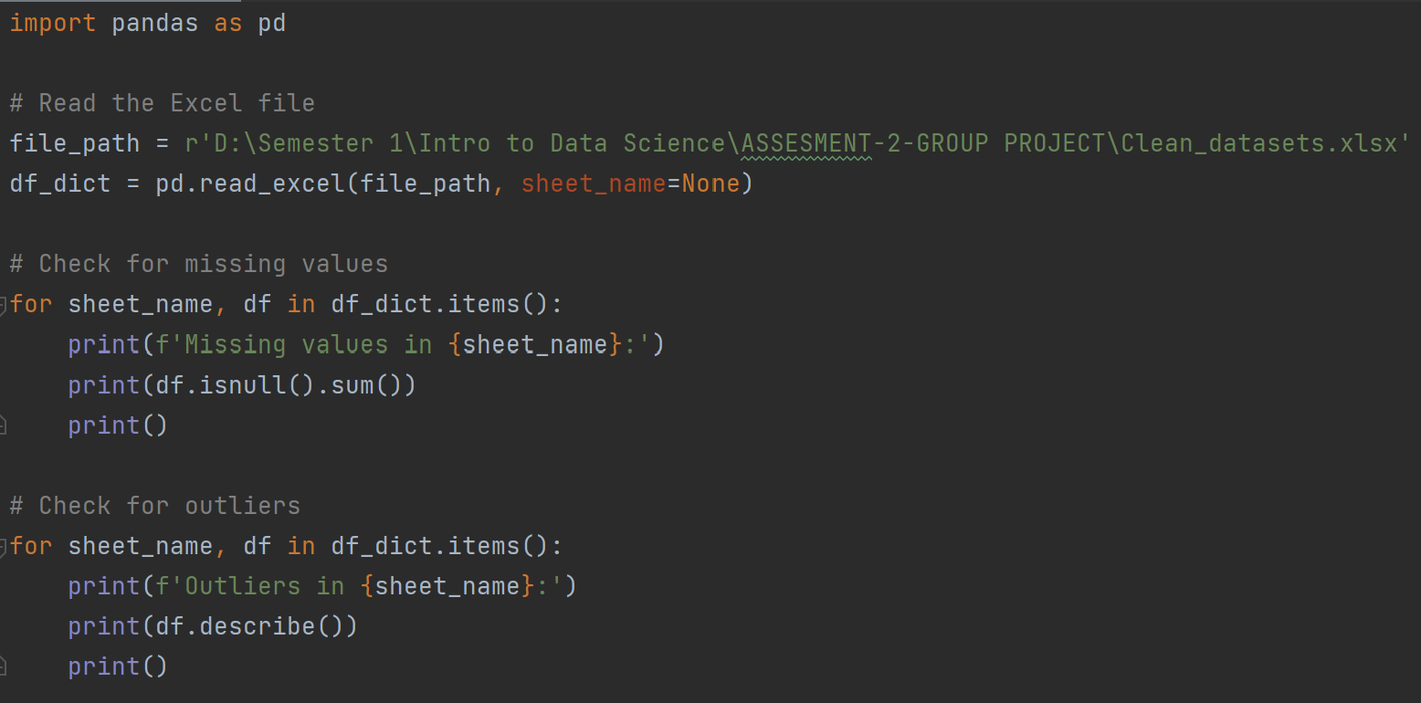
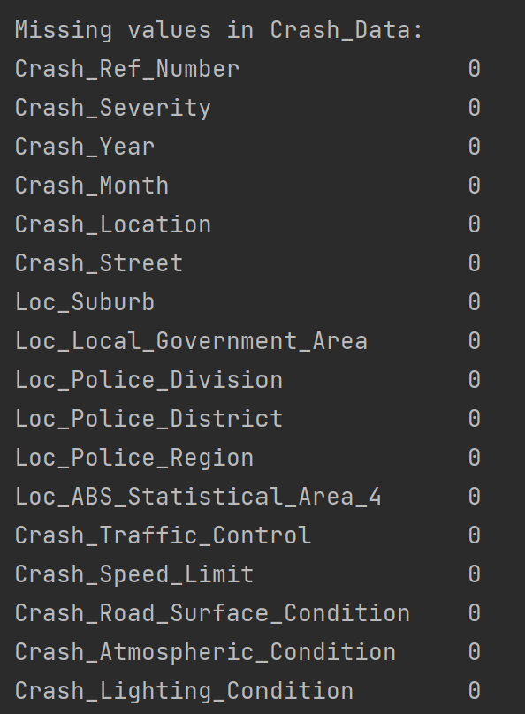
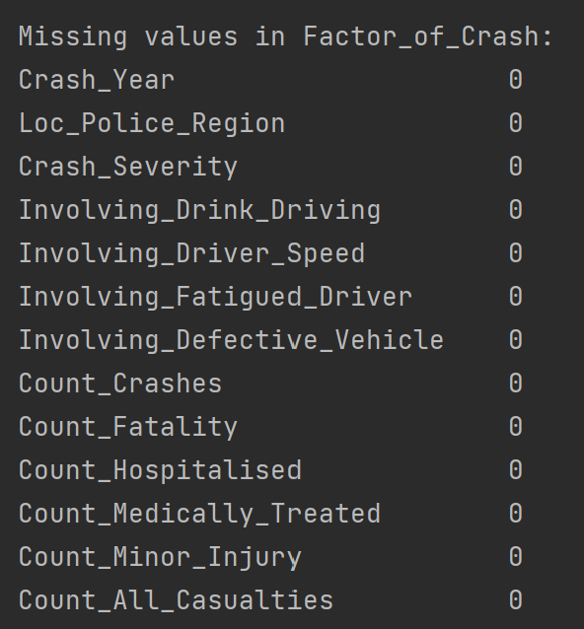
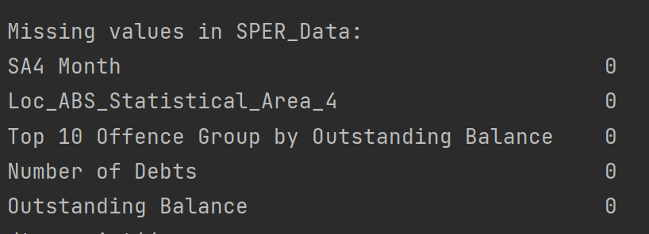
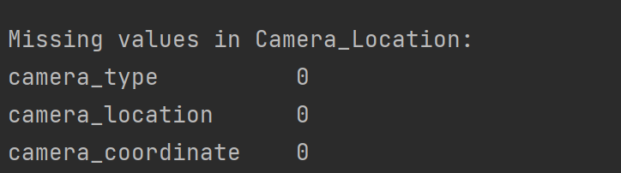
APPENDIX
Is The Data Fit for Use?
1.1 Check for Completeness
06

Slide 4
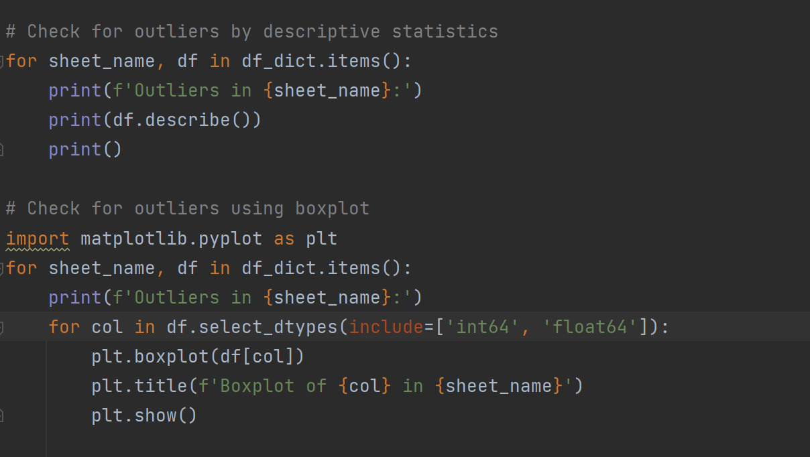
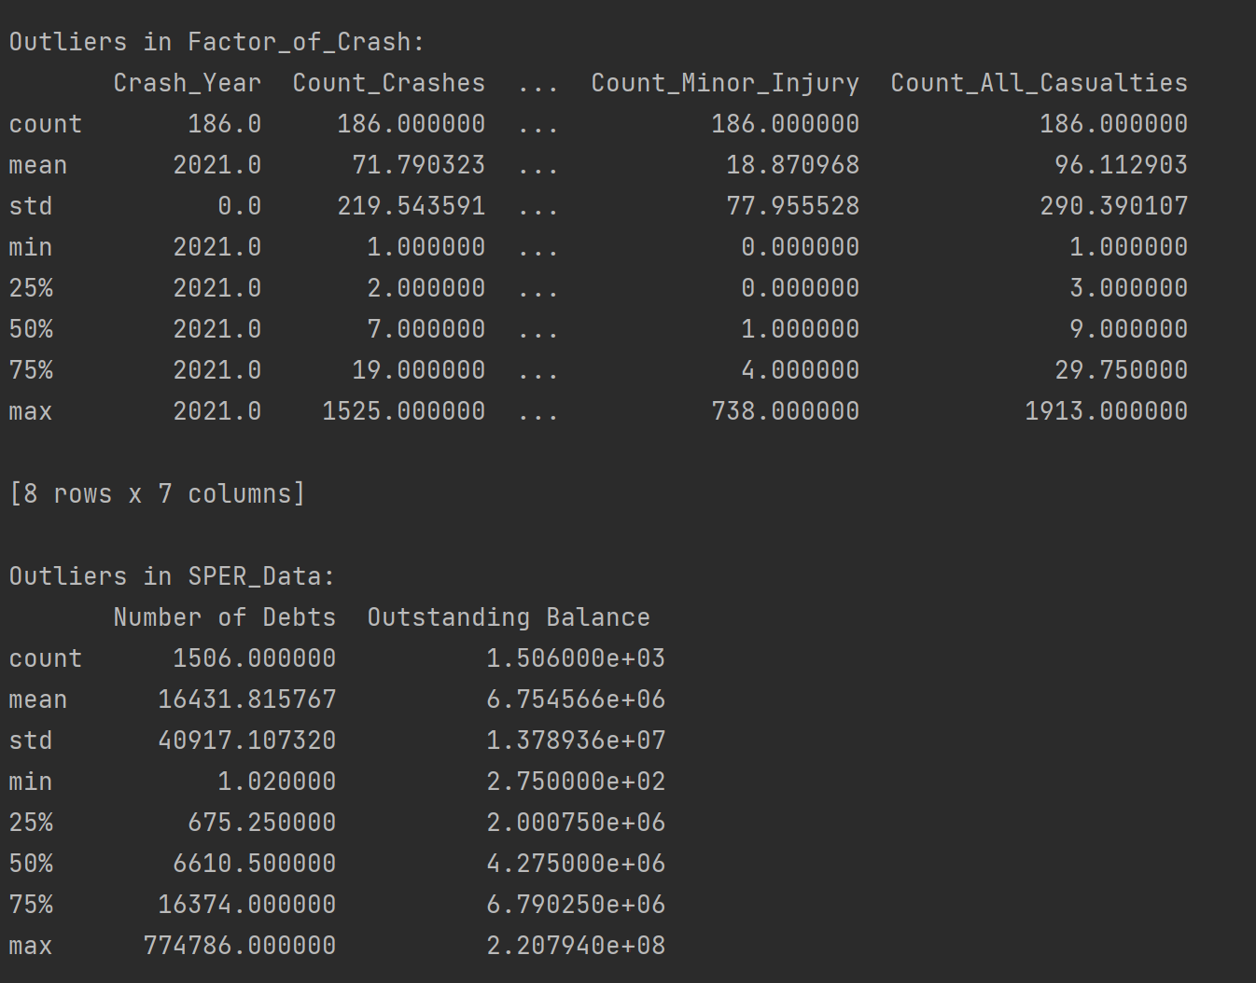
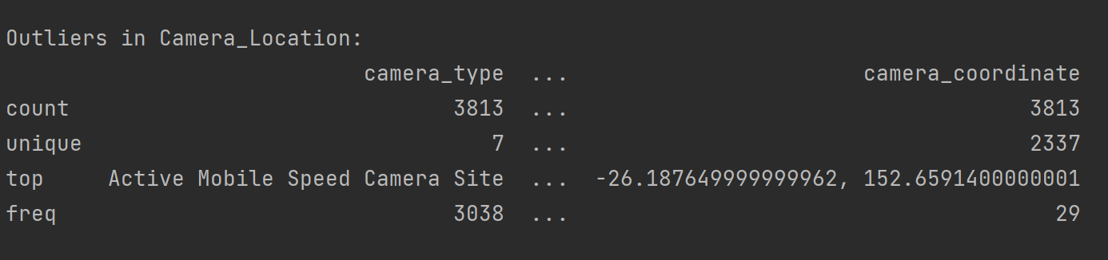
APPENDIX
Is The Data Fit for Use?
1.2 Check for Outliers
06

Slide 5
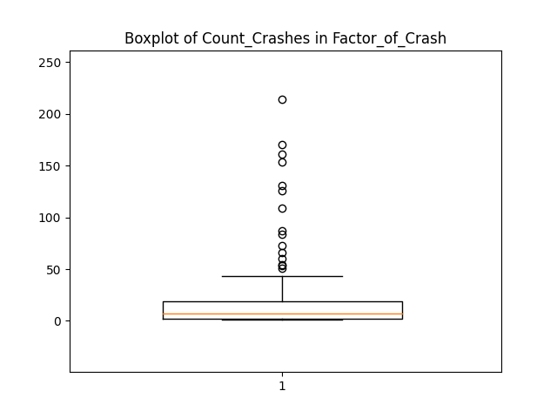
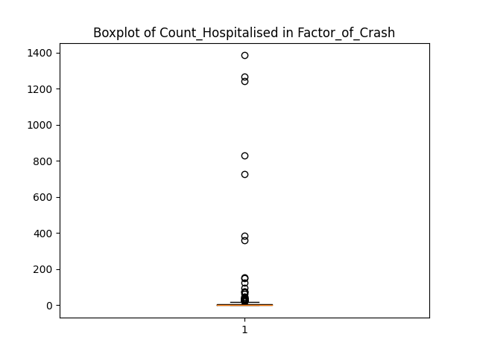
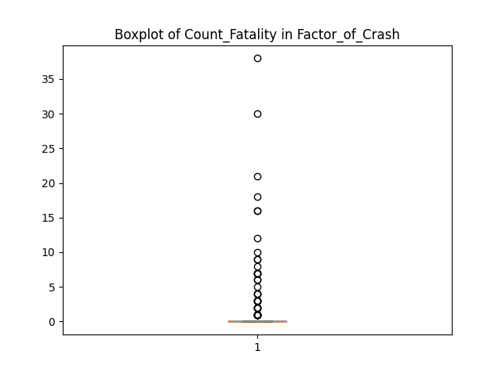
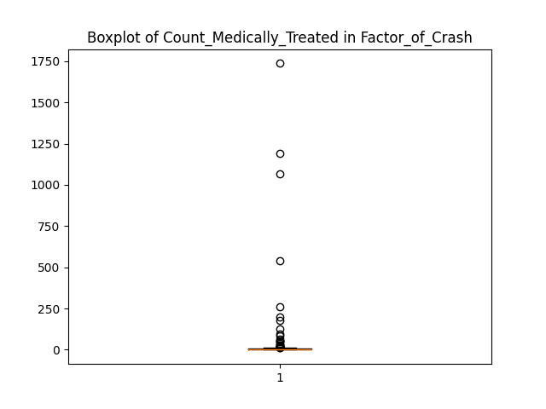
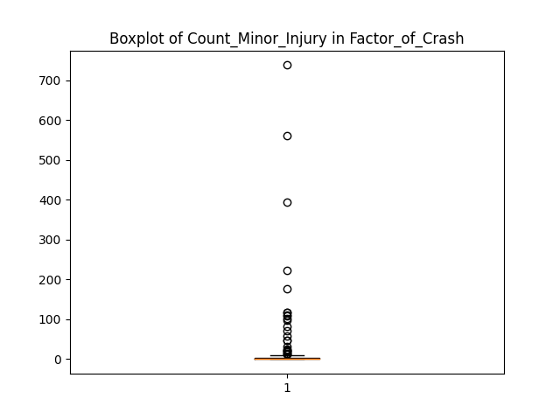
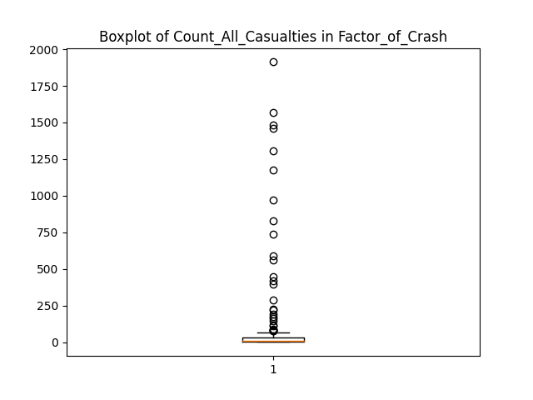
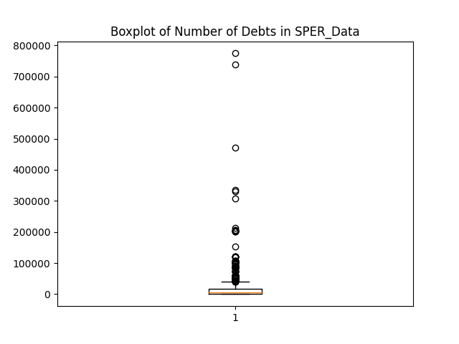
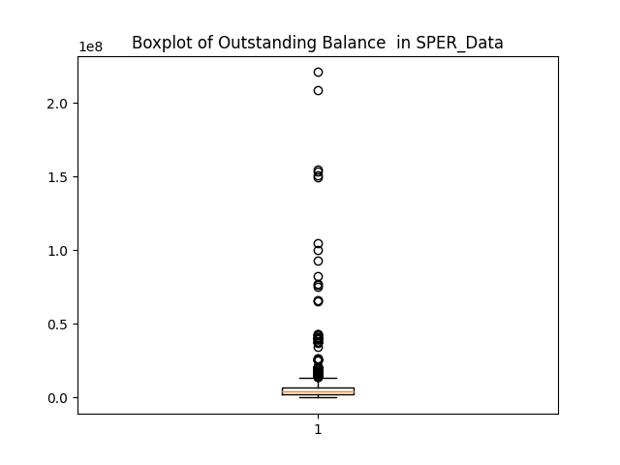
APPENDIX
Is The Data Fit for Use?
1.2 Check for Outliers
06

Slide 6
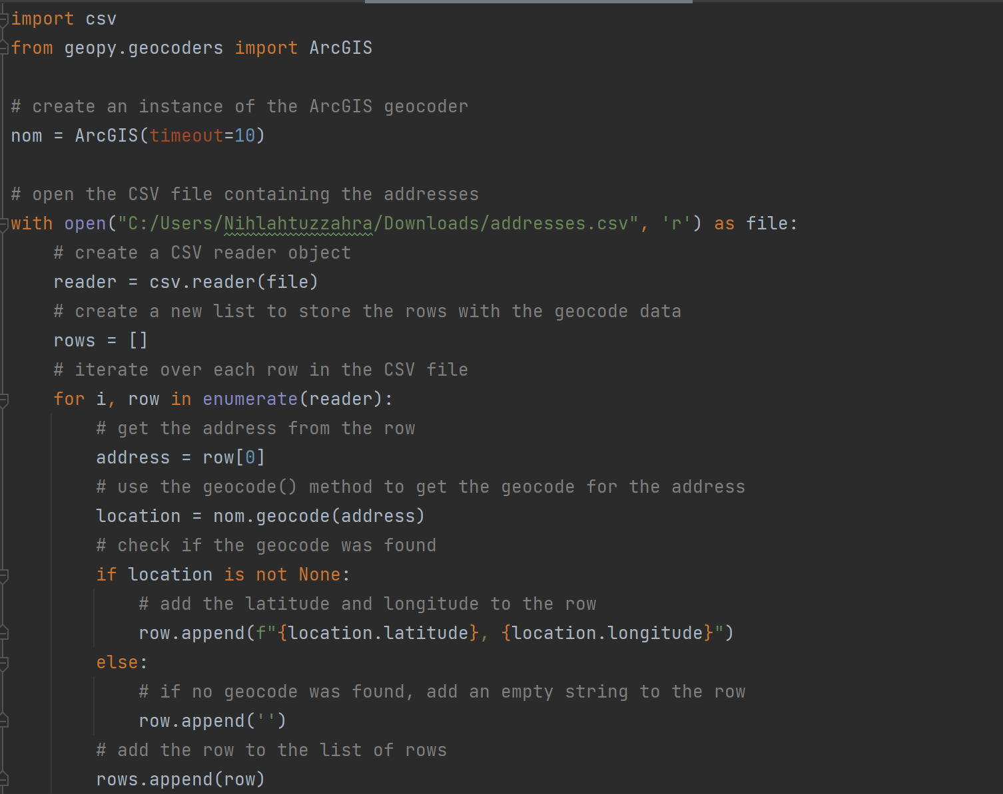
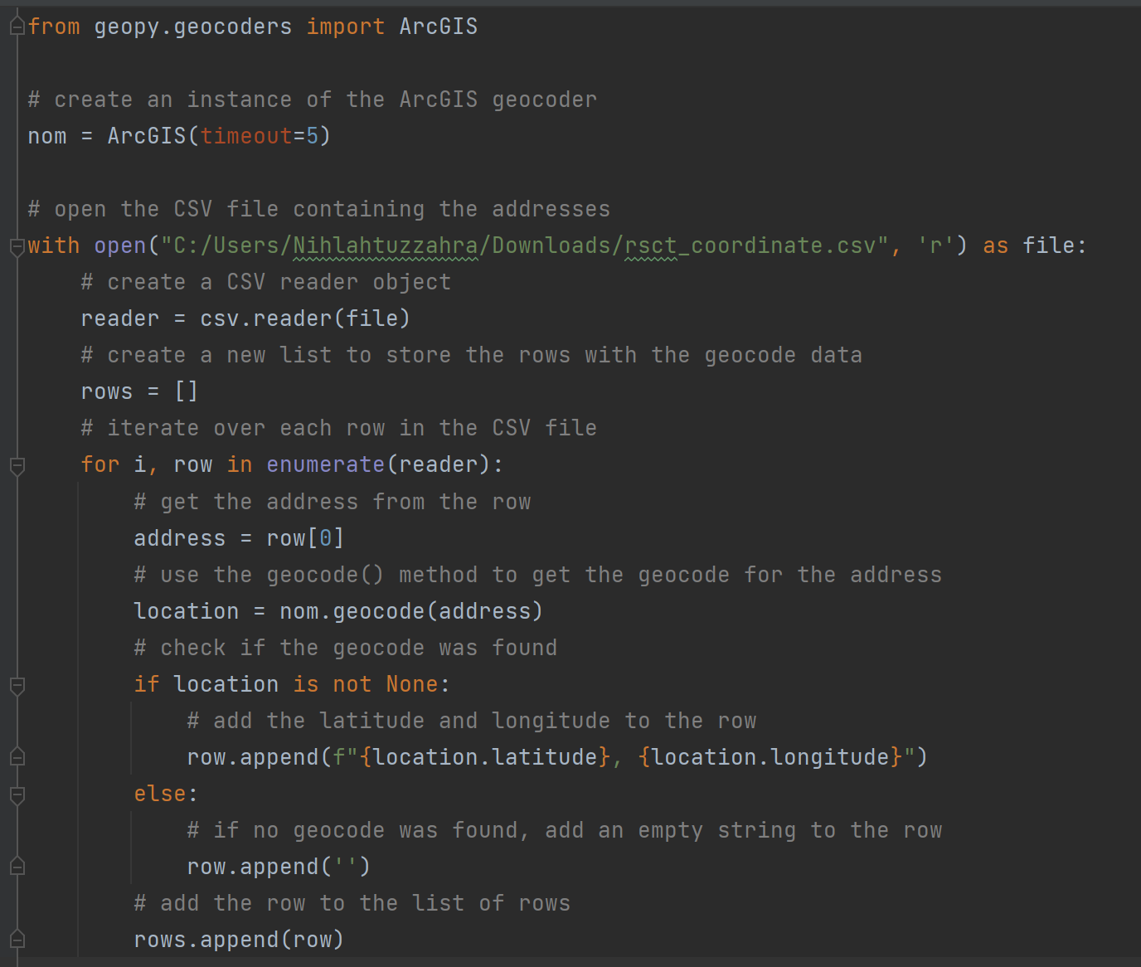
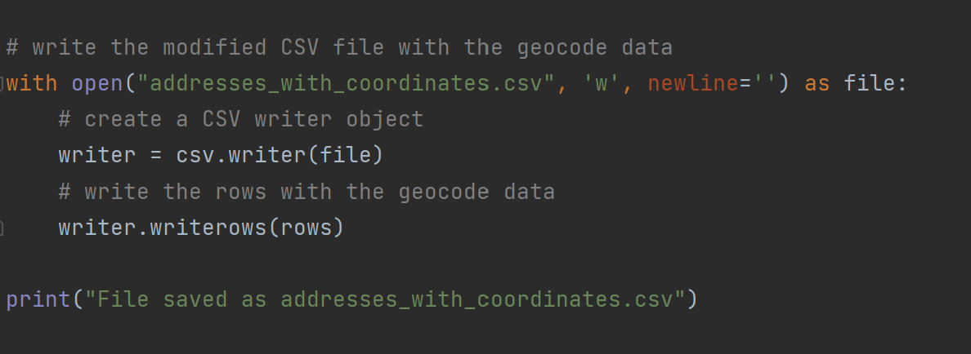
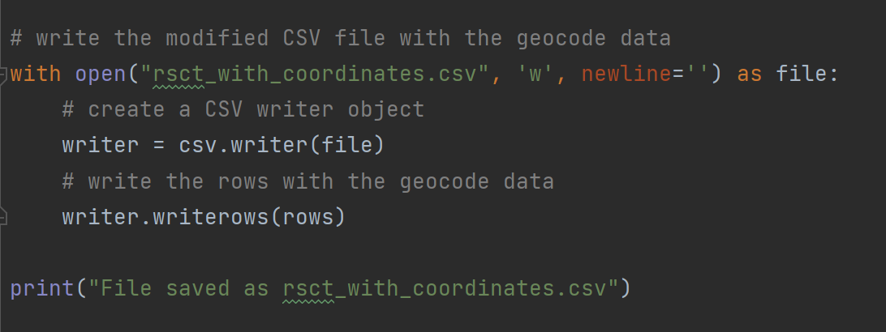
APPENDIX
Is The Data Fit for Use?
1.3 Find the coordinate of mobile speed camera
1.4 Find the coordinate of road safety camera
06

Slide 7
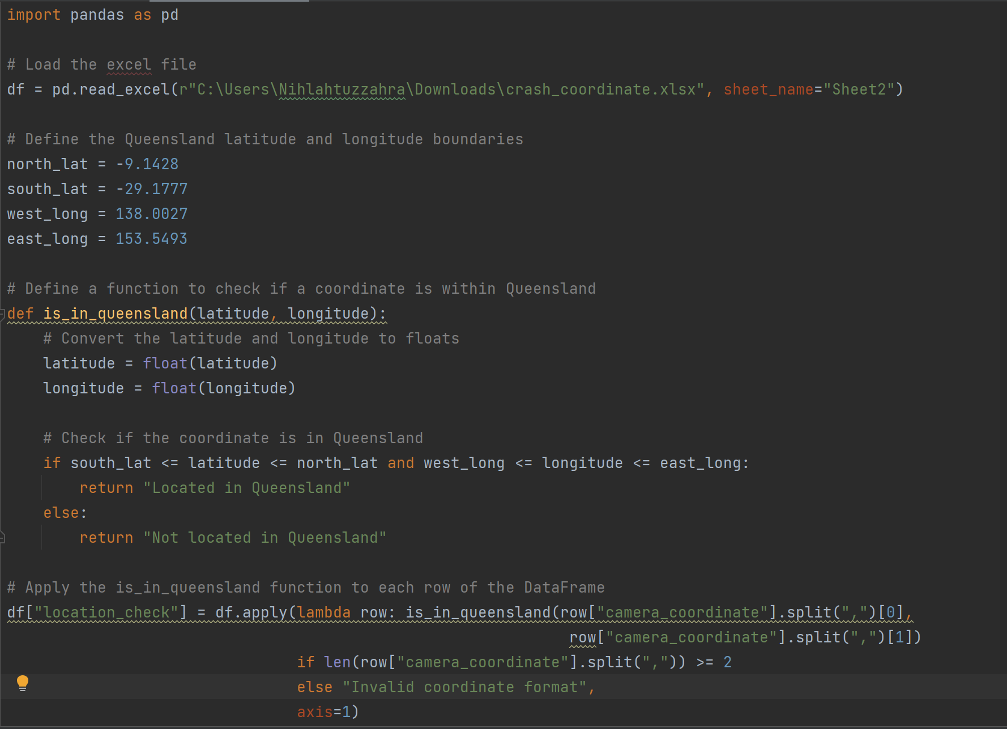
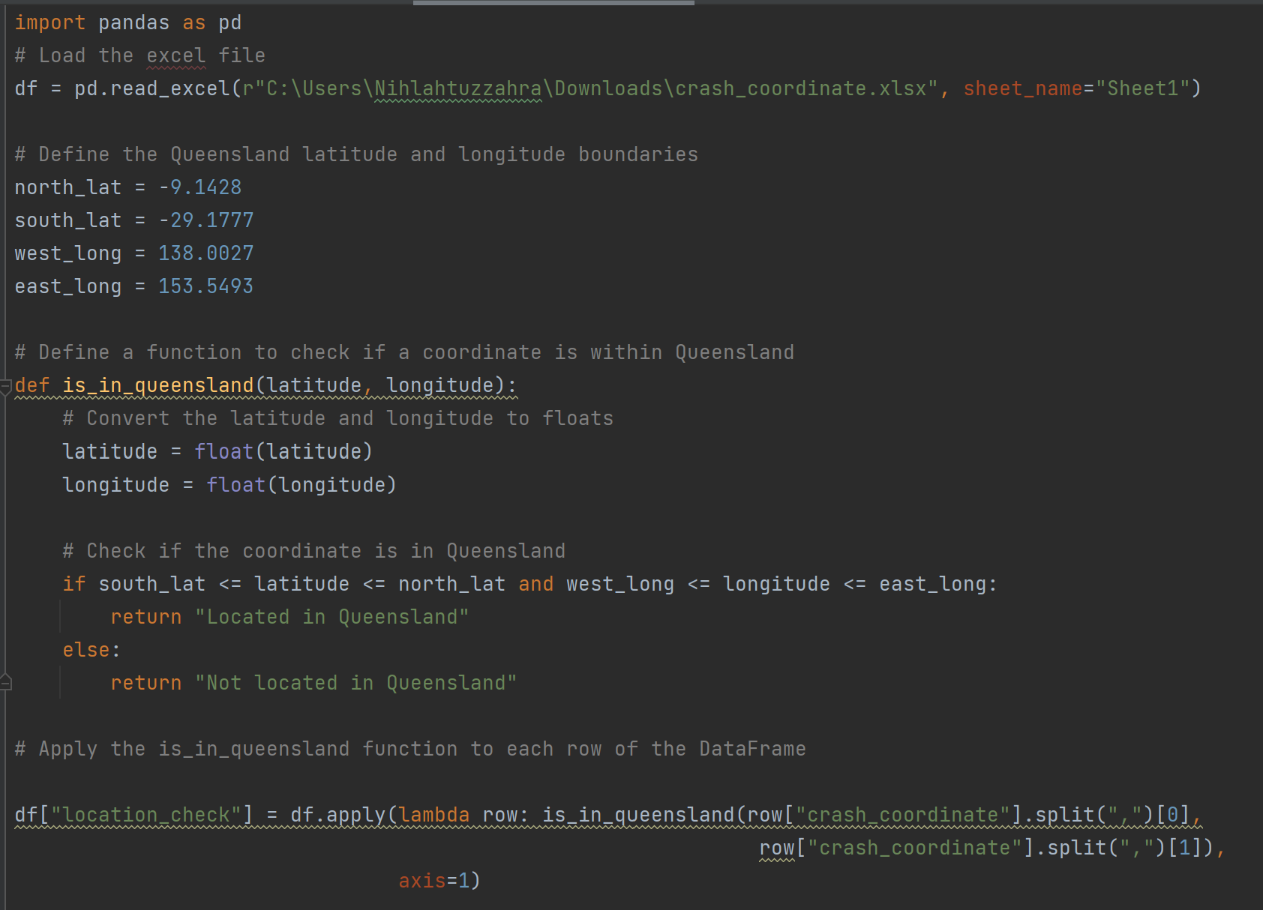
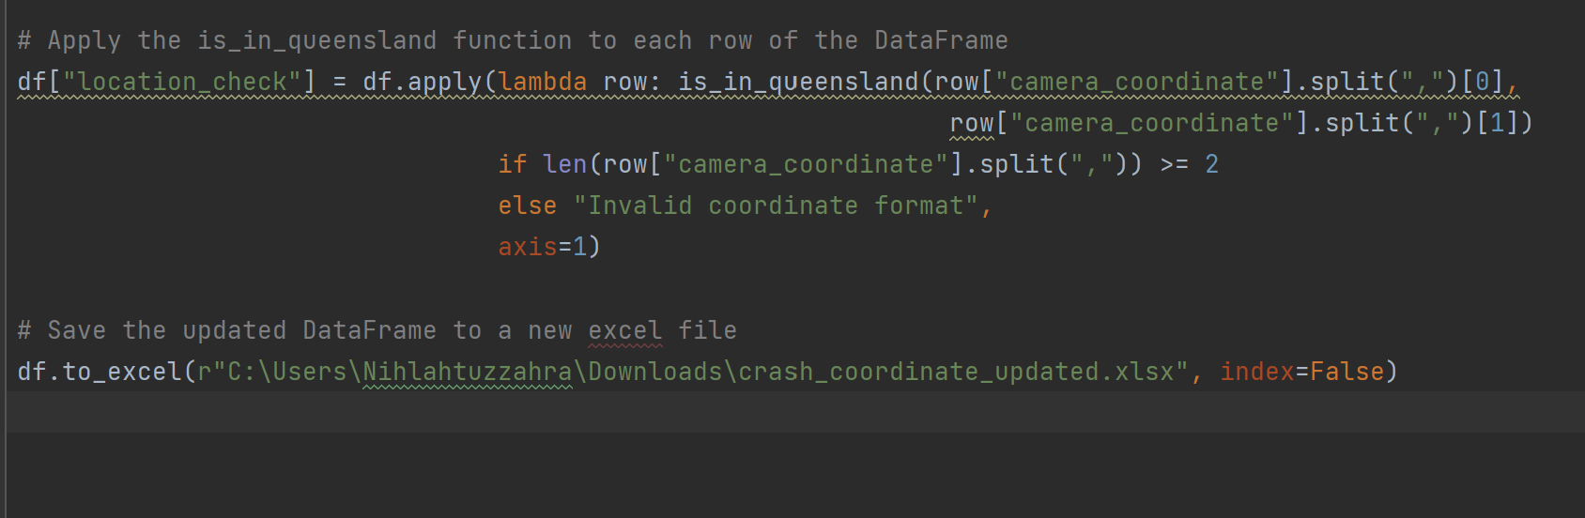
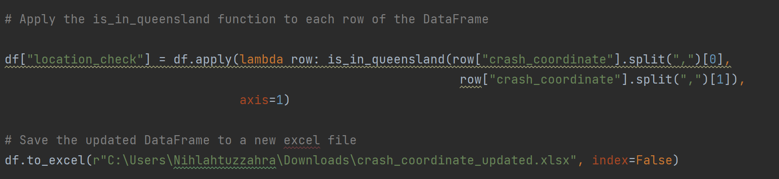
APPENDIX
Is The Data Fit for Use?
1.5 Checking the coordinate of camera
1.6 Checking the coordinate of crash
06

Slide 8
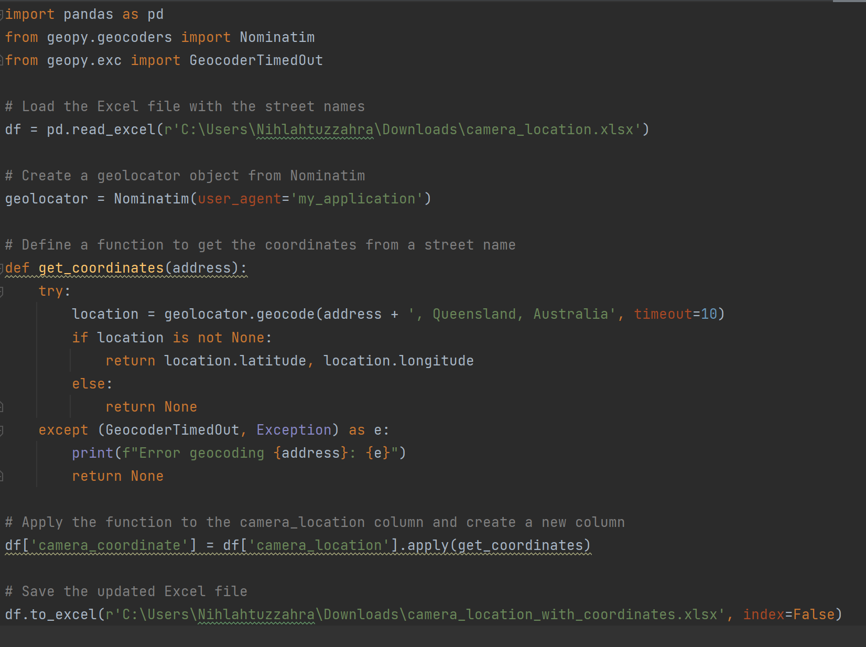
APPENDIX
Is The Data Fit for Use?
1.7 Finding the right camera location (located in Queensland)
06

Slide 9
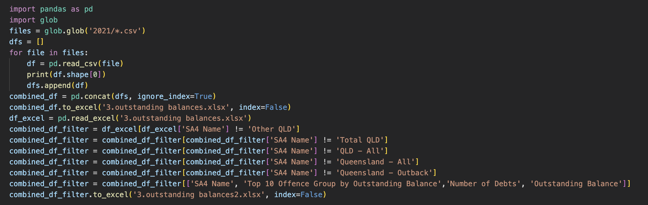
APPENDIX
Is The Data Fit for Use?
1.8 Create consistency of ABS SA4 Areas
06

Slide 10
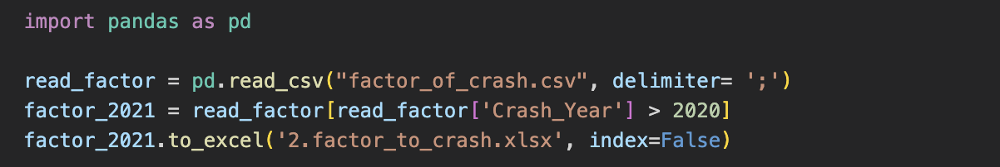
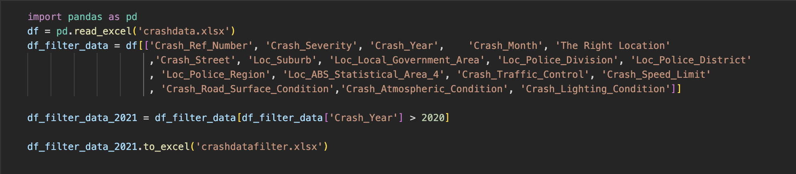
APPENDIX
Is The Data Fit for Use?
1.9. Year Consistency (Only use 2021)
Crash Factor Dataset
The Crash Dataset
06

Slide 11
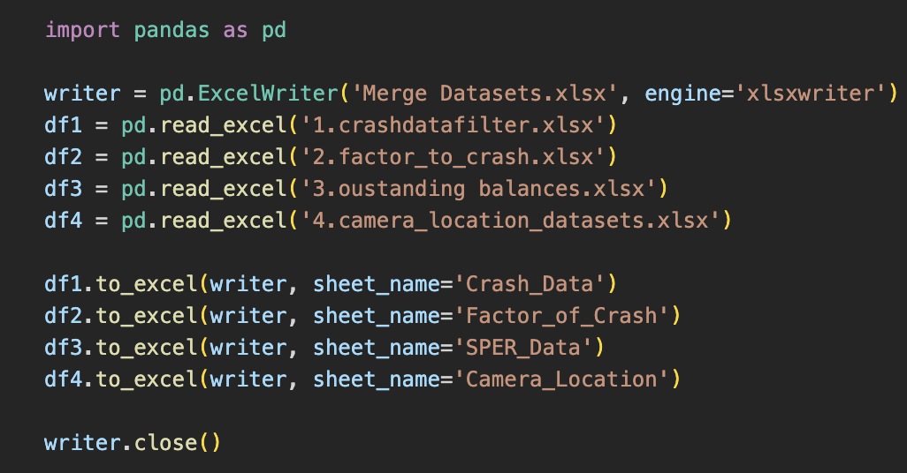
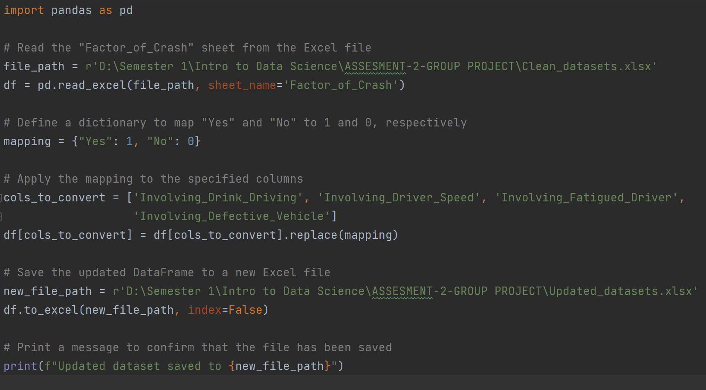
APPENDIX
Is The Data Fit for Use?
1.10 Merging 4 datasets
1.11 Data Transformations Factor of Crash

Slide 12
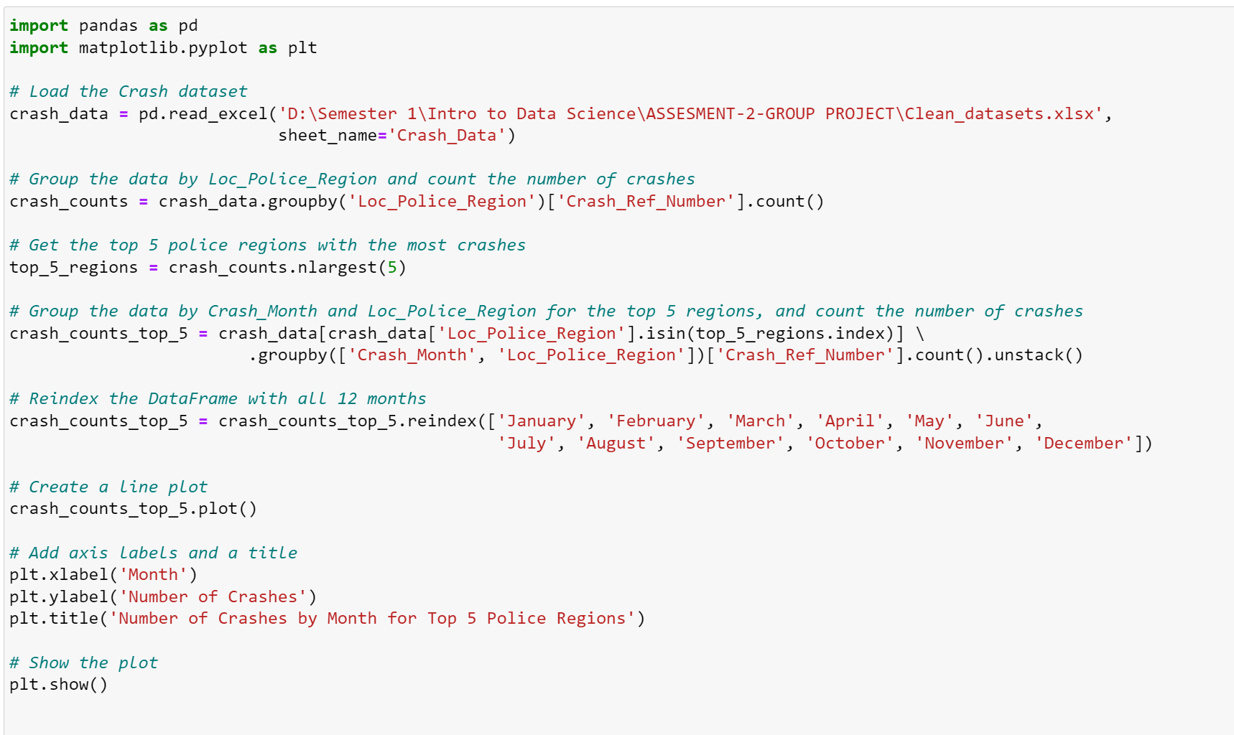
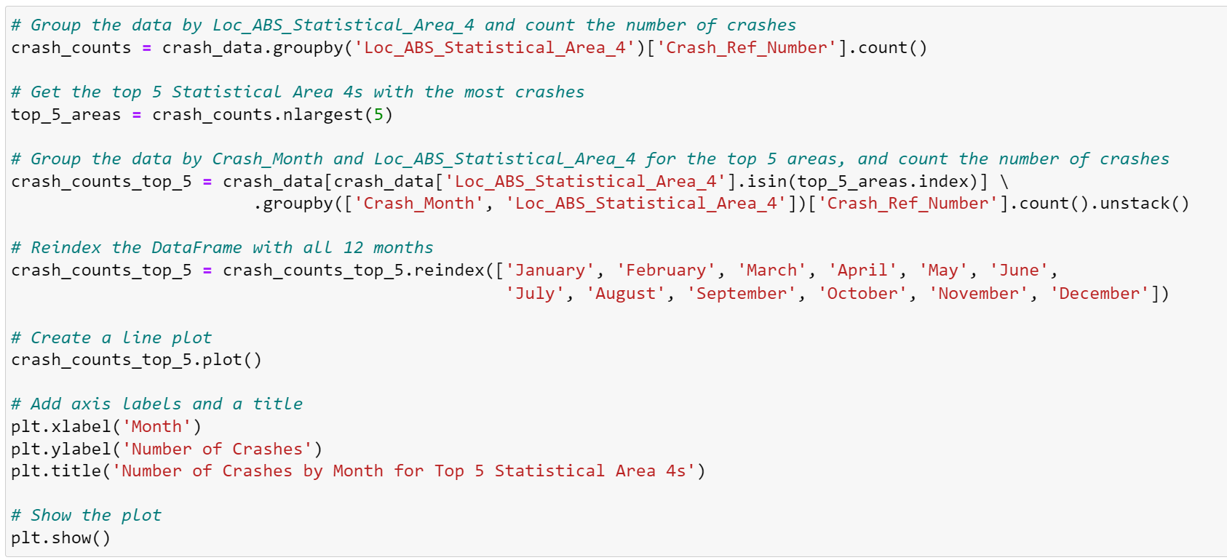
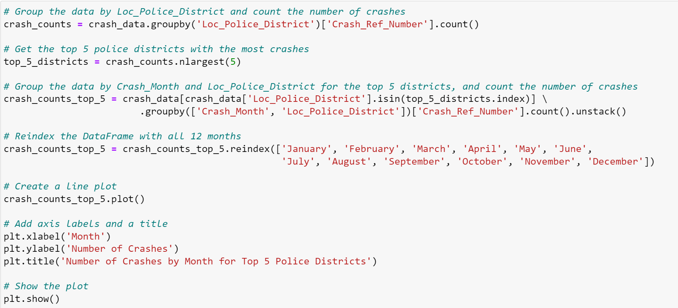
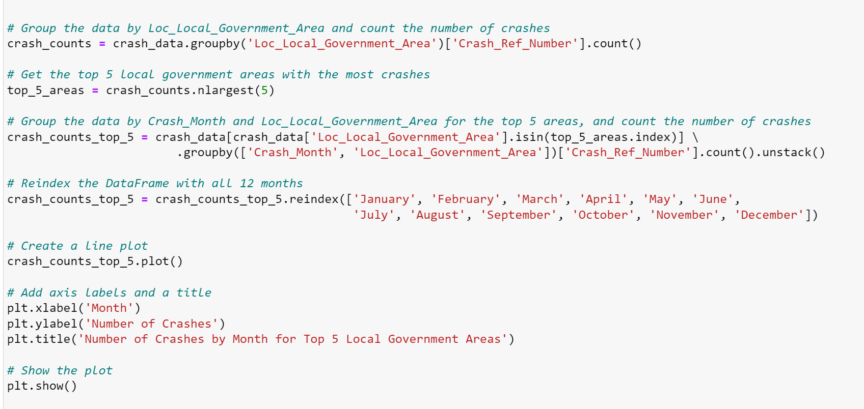
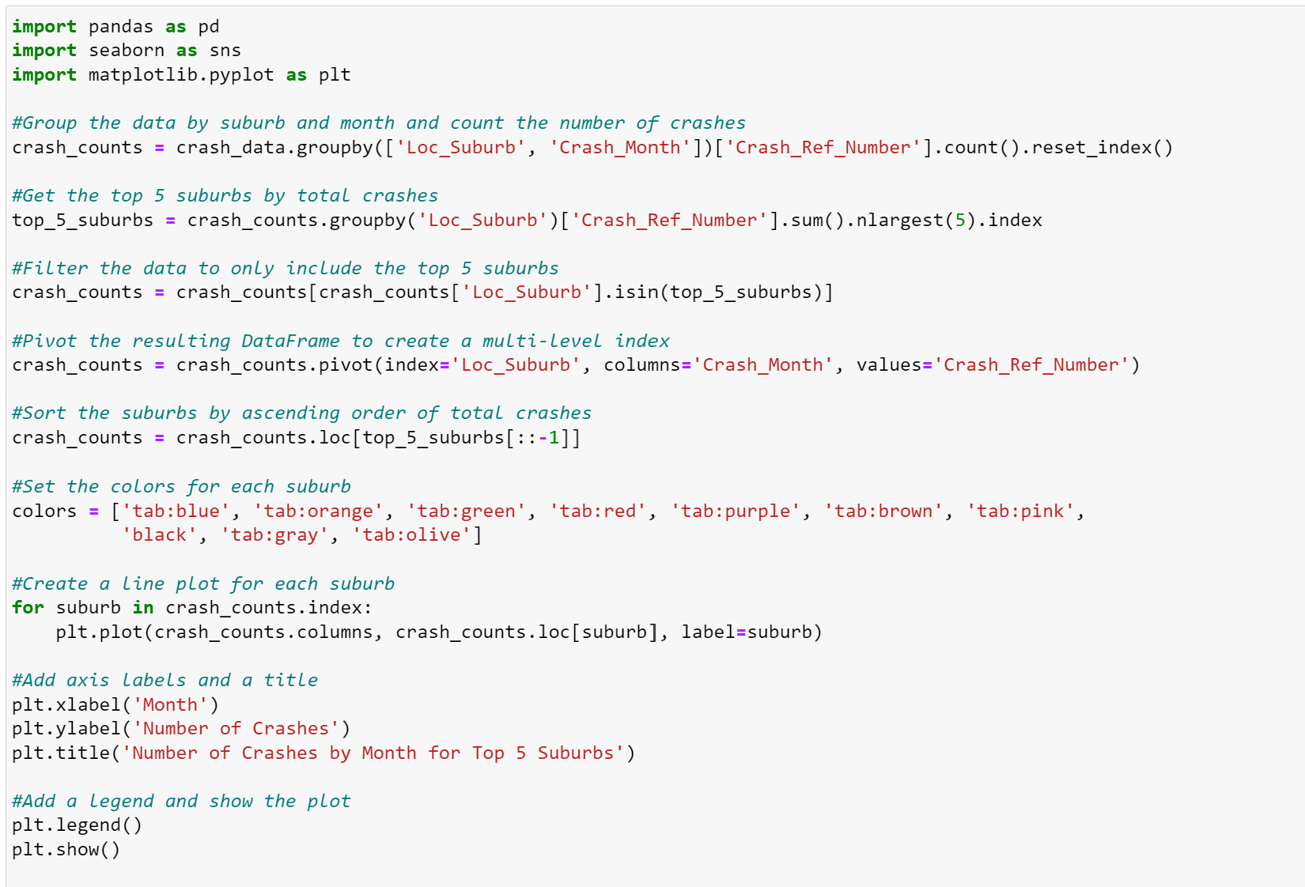
APPENDIX
2. Making The Data Confess
2.1 Exploration for top five areas with the highest number of crashes throughout the year

Slide 13
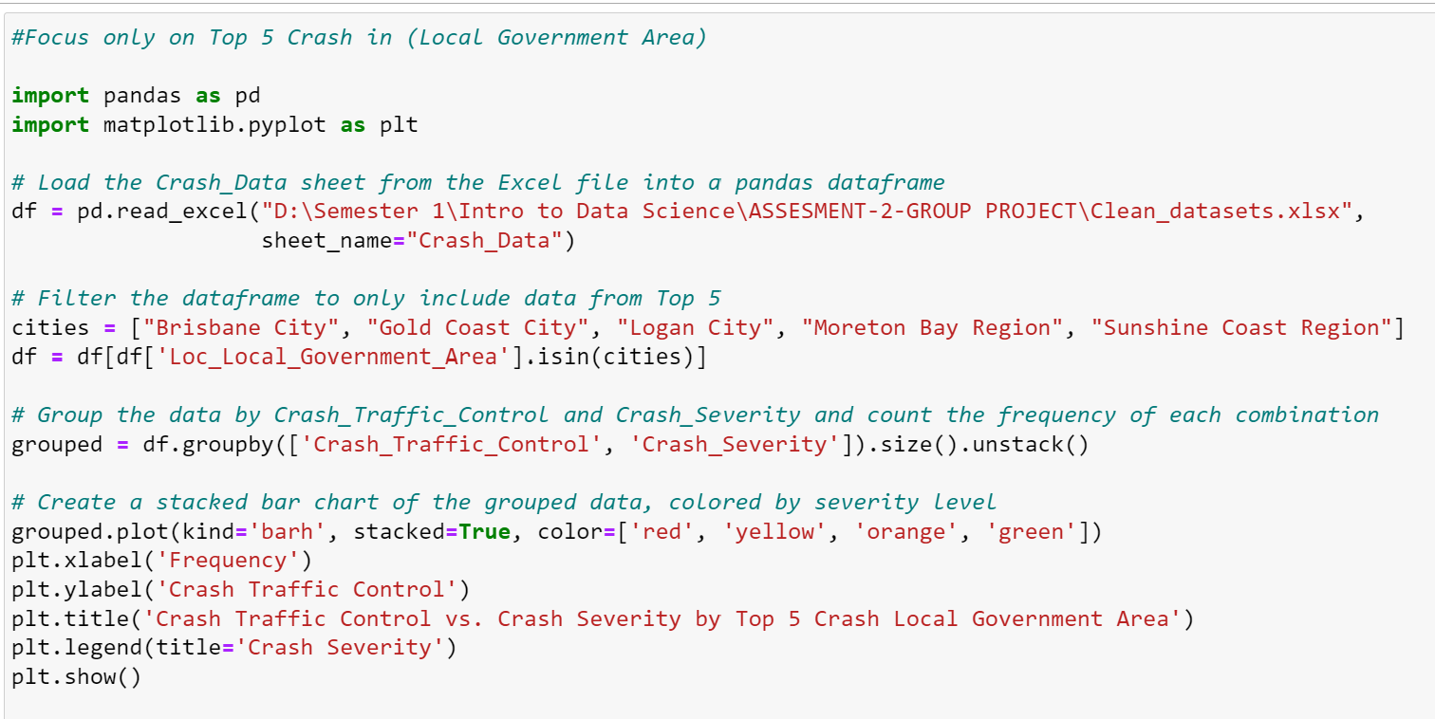
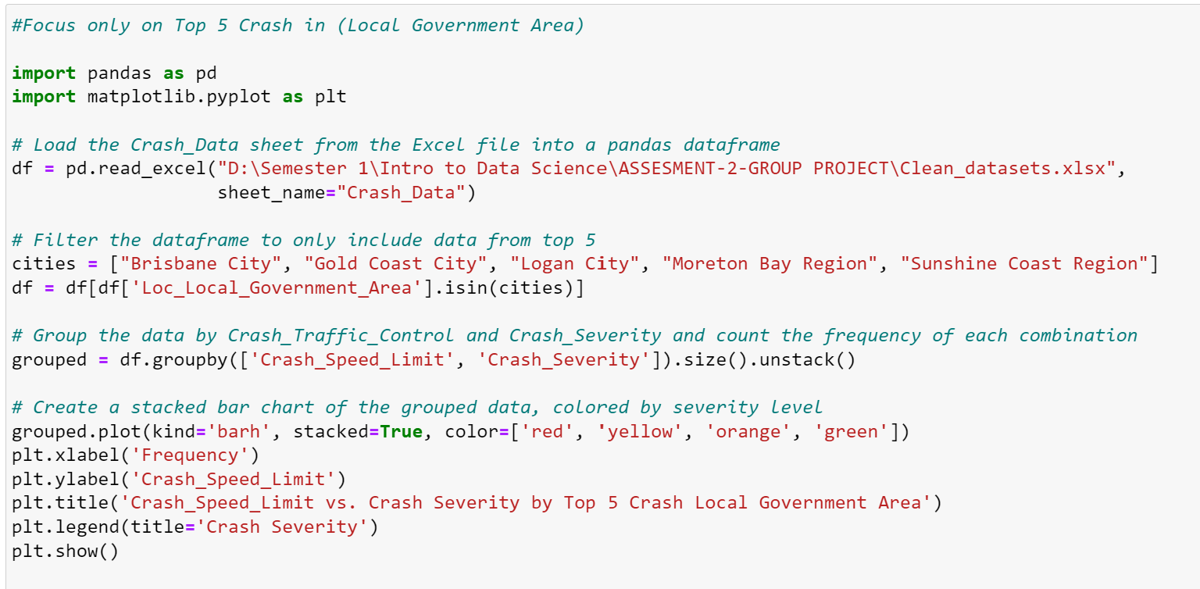
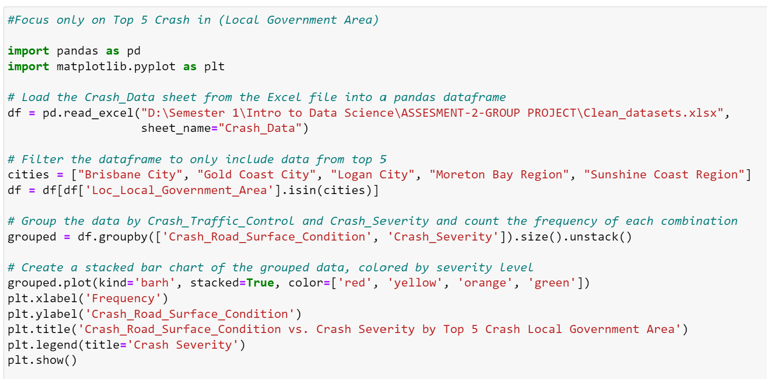
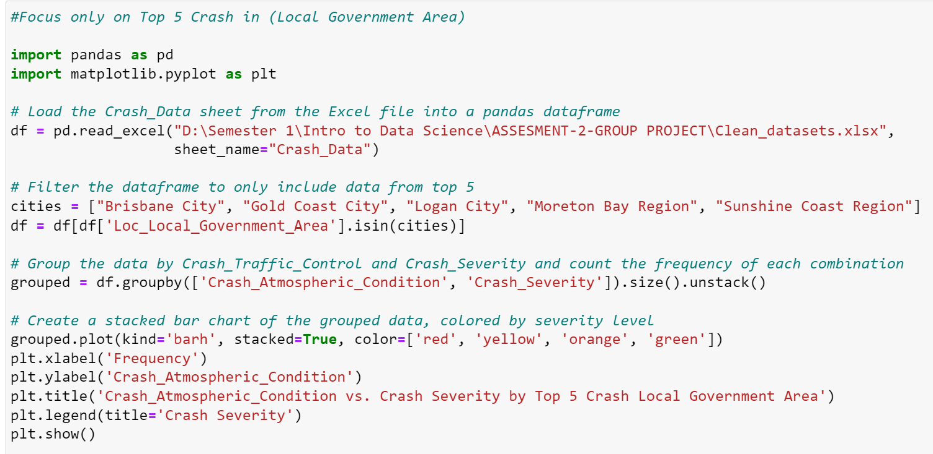
APPENDIX
2. Making The Data Confess
2.1 Exploration for factors that contributed to the crashes severity in top 5 Local Government Areas

Slide 14
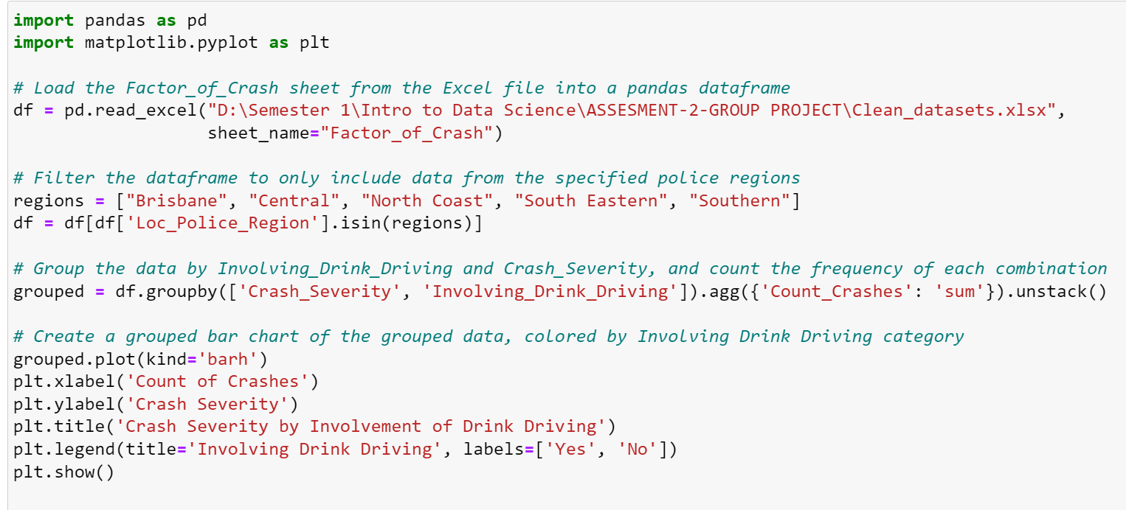
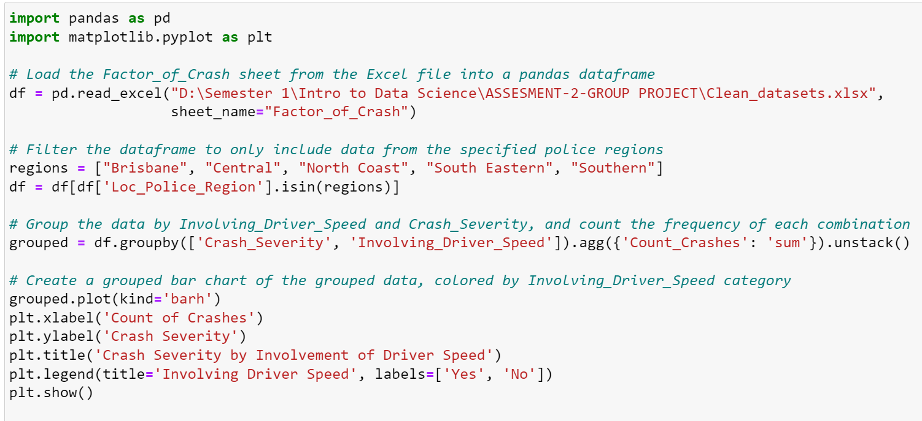
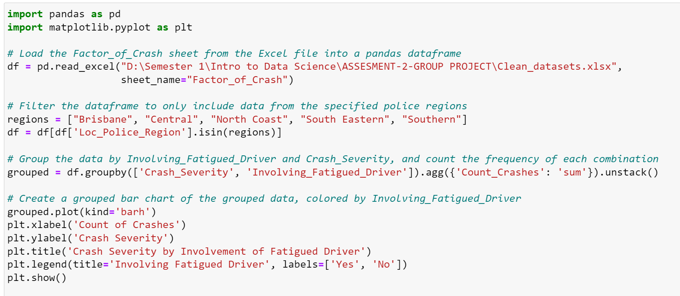
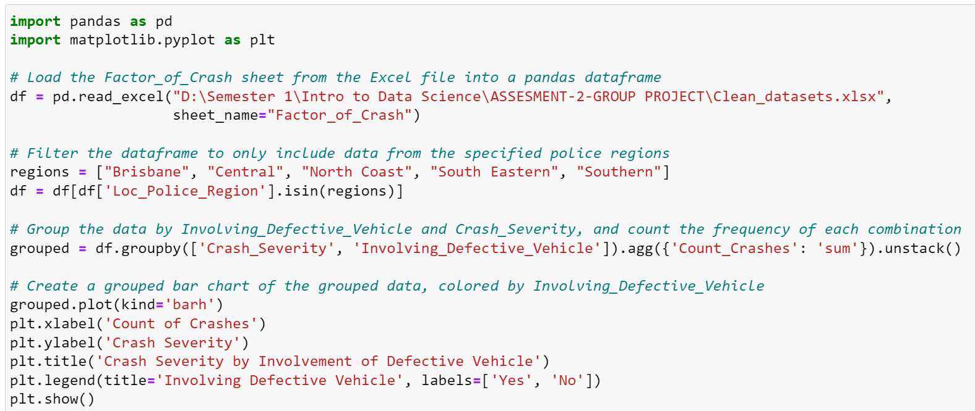
APPENDIX
2. Making The Data Confess
2.2 Factors that contributed to the severity of the crashes in the top 5 Local Police Regions

Slide 15
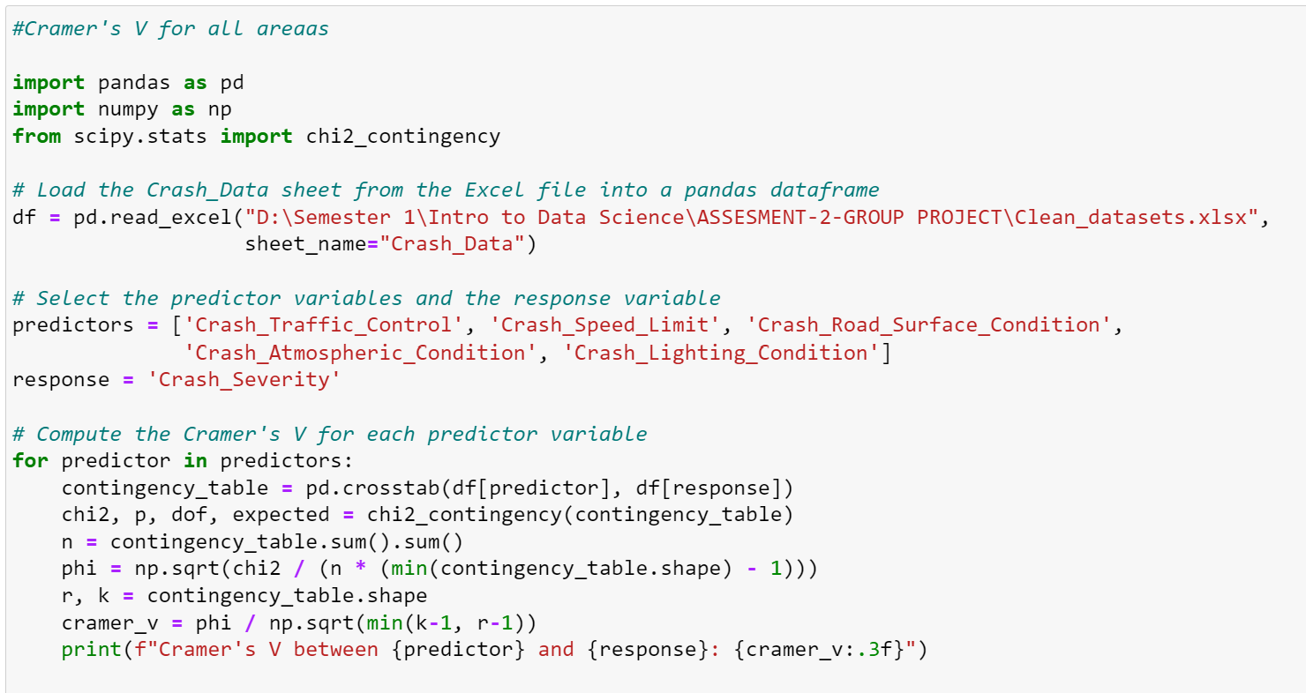
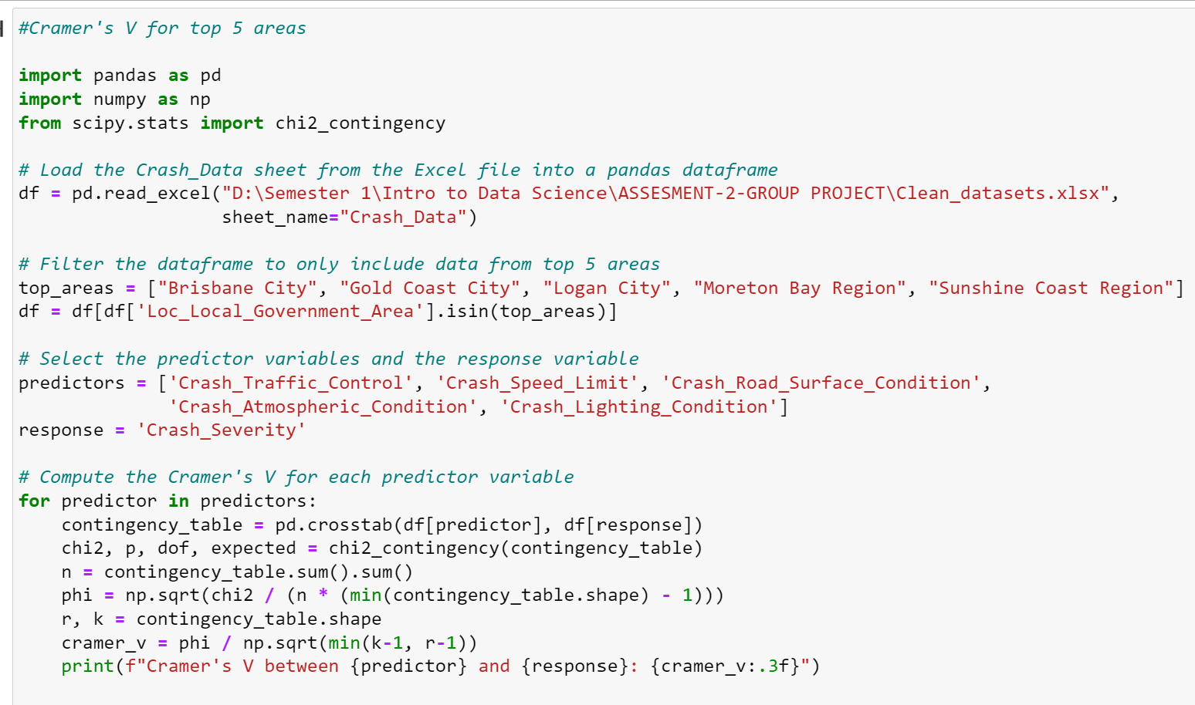
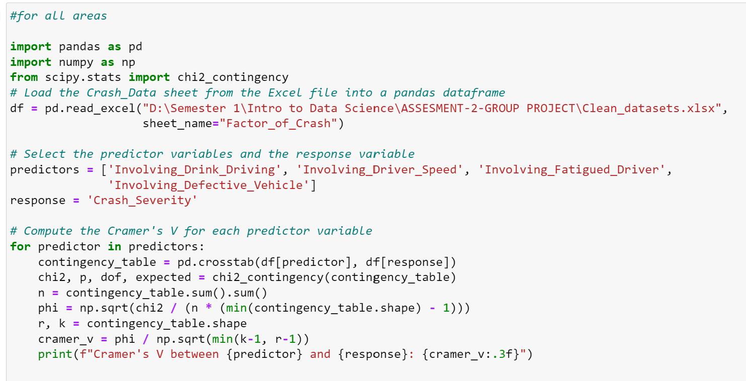
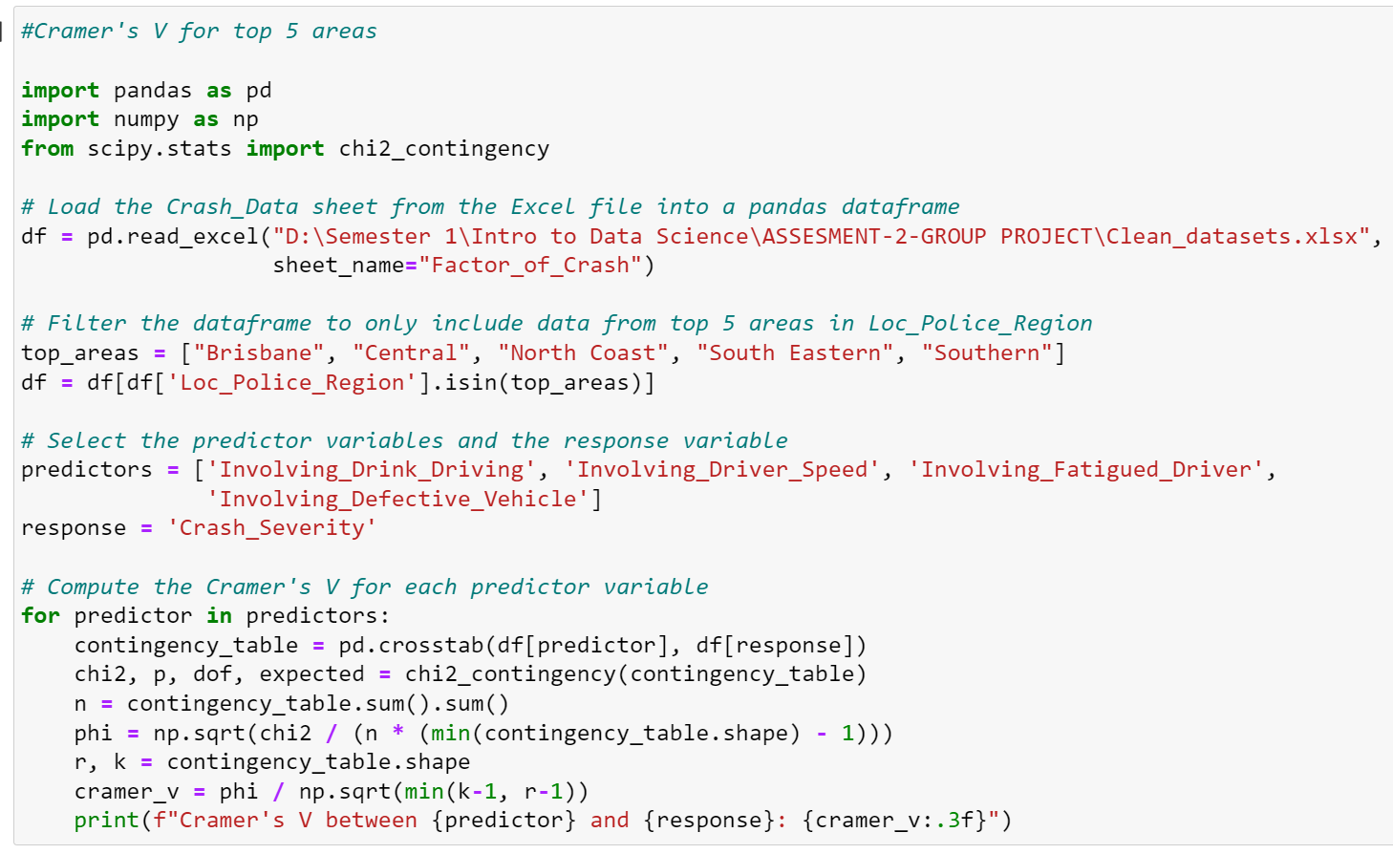
APPENDIX
2. Making The Data Confess
2.3. Association strength between factors of crash to the crash severity in all areas and in top 5 crash
2.4. Association strength between involvement factors of crash to the crash severity in all areas and in top 5 crash

Slide 16
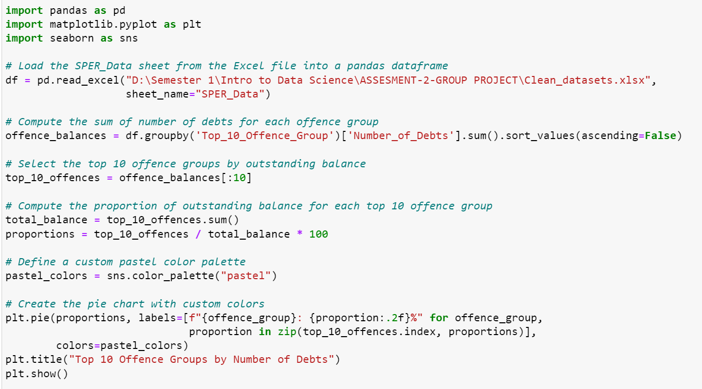
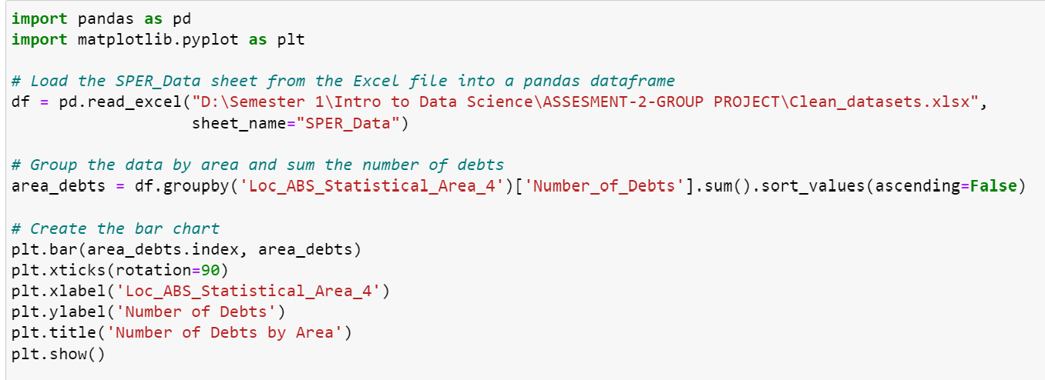
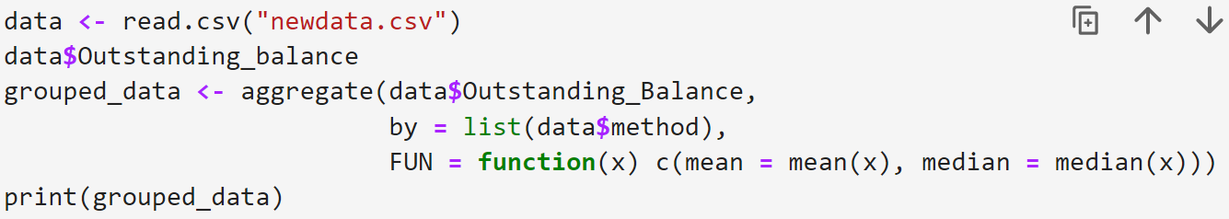


APPENDIX
2. Making The Data Confess
2.5. Top 10 Offence Contributed to Number of Debts
2.6. Top 10 Offence Contributed to Number of Outstanding Balance

Slide 17


APPENDIX
2. Making The Data Confess
2.7 Proportion of Offence Contributed to Outstanding Balance
2.8 Correlations and Regression Analysis to Outstanding Balance

Slide 18


APPENDIX
2. Making The Data Confess
2.9 Poisson Regression for Analyzing Involvement Factors to Count of Crashes

Slide 19

APPENDIX
2. Making The Data Confess
2.10 Poisson Regression for Analyzing Involvement Factors to Count of Casualties

Slide 20

APPENDIX
2.11 Plotting Scatter graph: Comparing Crash Location and Camera Location

Slide 21

APPENDIX
2.11 Plotting Scatter graph: Comparing Crash Location and Camera Location

Slide 22

APPENDIX
2.11 Plotting Scatter graph: Comparing Crash Location and Camera Location

Slide 23

APPENDIX
2.11 Plotting Scatter graph: Comparing Crash Location and Camera Location

Slide 24

APPENDIX
2.11 Plotting Scatter graph: Comparing Crash Location and Camera Location

Slide 25

APPENDIX
2.11 Plotting Scatter graph: Comparing Crash Location and Camera Location

Slide 26
We used a Poisson regression model to fit the training data to see if there is a linear relationship between "Involving Drink Driving" / "Involving Driver Speed" / "Involving Fatigued Driver" / "Involving Defective Vehicle" and the total number of crashes ("Count_Crashes"). We output the model summary and fitting results. If the red line is a straight line, it means that in this model, the relationship between the dependent variable (Crash Count) and the independent variable can be described by a linear function. This means that the impact of a one-unit increase in each independent variable on the dependent variable is constant, i.e., this relationship is linear.

Slide 27


Count_crashes with involving_drink_driving

Slide 28


Count_crashes with involving_driver_speed

Slide 29


Count_crashes with involving_fatigued_driver

Slide 30


Count_crashes with involving_defective_vehicle

Slide 31


Count_crashes with
Involving_Drink_Driving | Involving_Driver_Speed | Involving_Fatigued_Driver | Involving_Defective_Vehicle

Slide 32
We used a Poisson regression model to fit the training data to investigate whether there is a linear relationship between the variables "Involving Drink Driving," "Involving Driver Speed," "Involving Fatigued Driver," "Involving Defective Vehicle," and the number of casualties (Count_All_Casualties) caused by car crashes. We then generated a model summary and fitted the model. If the red line is a straight line, it means that in this model, the relationship between the dependent variable (Crash Count_All_Casualties) and the independent variable can be described by a linear function. This also means that the effect of each unit increase in the independent variable on the dependent variable is constant, indicating a linear relationship.

Slide 33


Count all casualties with involving drink driving

Slide 34


Count all casualties with involving fatigued driver

Slide 35


Count all casualties with involving driver speed

Slide 36


Count all casualties with involving defective vehicle

Slide 37


Count all casualties with involving drink driving, involving fatigued driver, involving driver speed, involving defective vehicle

